Slide 1
SESSÃO SILADEPA
Rafael de Deus Moura
UFPI e HU-UFPI

Slide 2
Disclosure of Relevant Financial Relationships
Dr. Rafael de Deus Moura declares he has no conflict(s) of interest to disclose
RDC Nº 96/08 da ANVISA

Slide 3
*XY, 66a;
*Pápula de 9 mm pedunculada com exulcerações superficiais em região inguinal, há 3 anos.
*Hipóteses clínicas: Fibroma mole? Granuloma Piogênico?

Slide 4
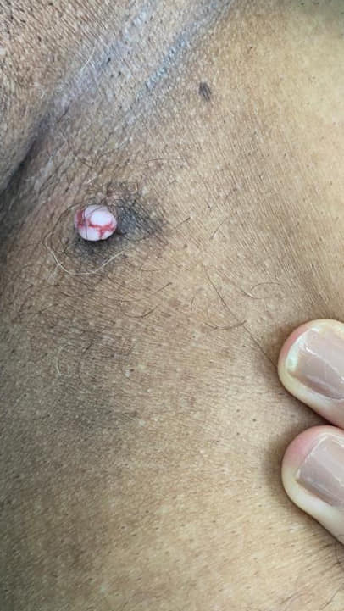
Região inguinal

Slide 5
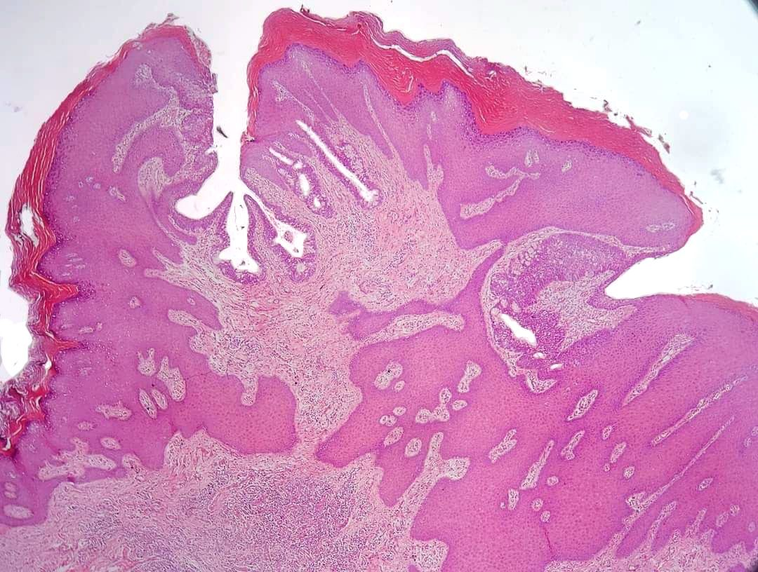
Acantose verrucosa

Slide 6
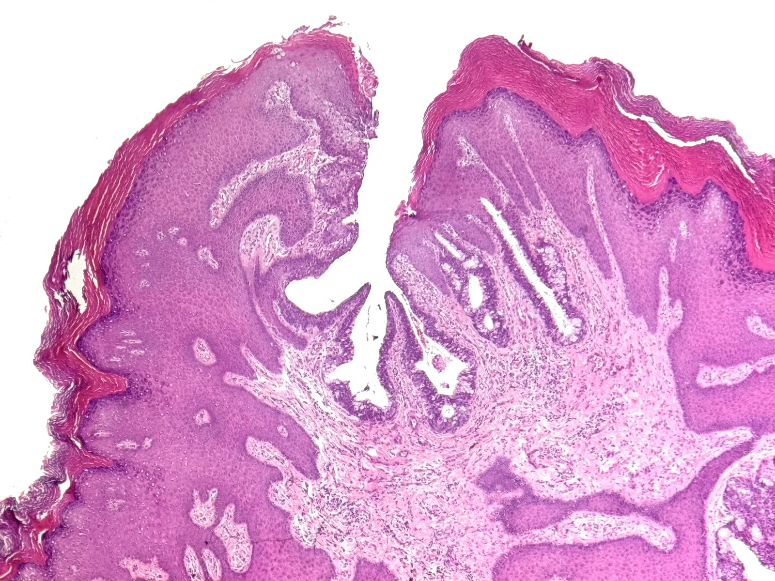
Invaginação

Slide 7
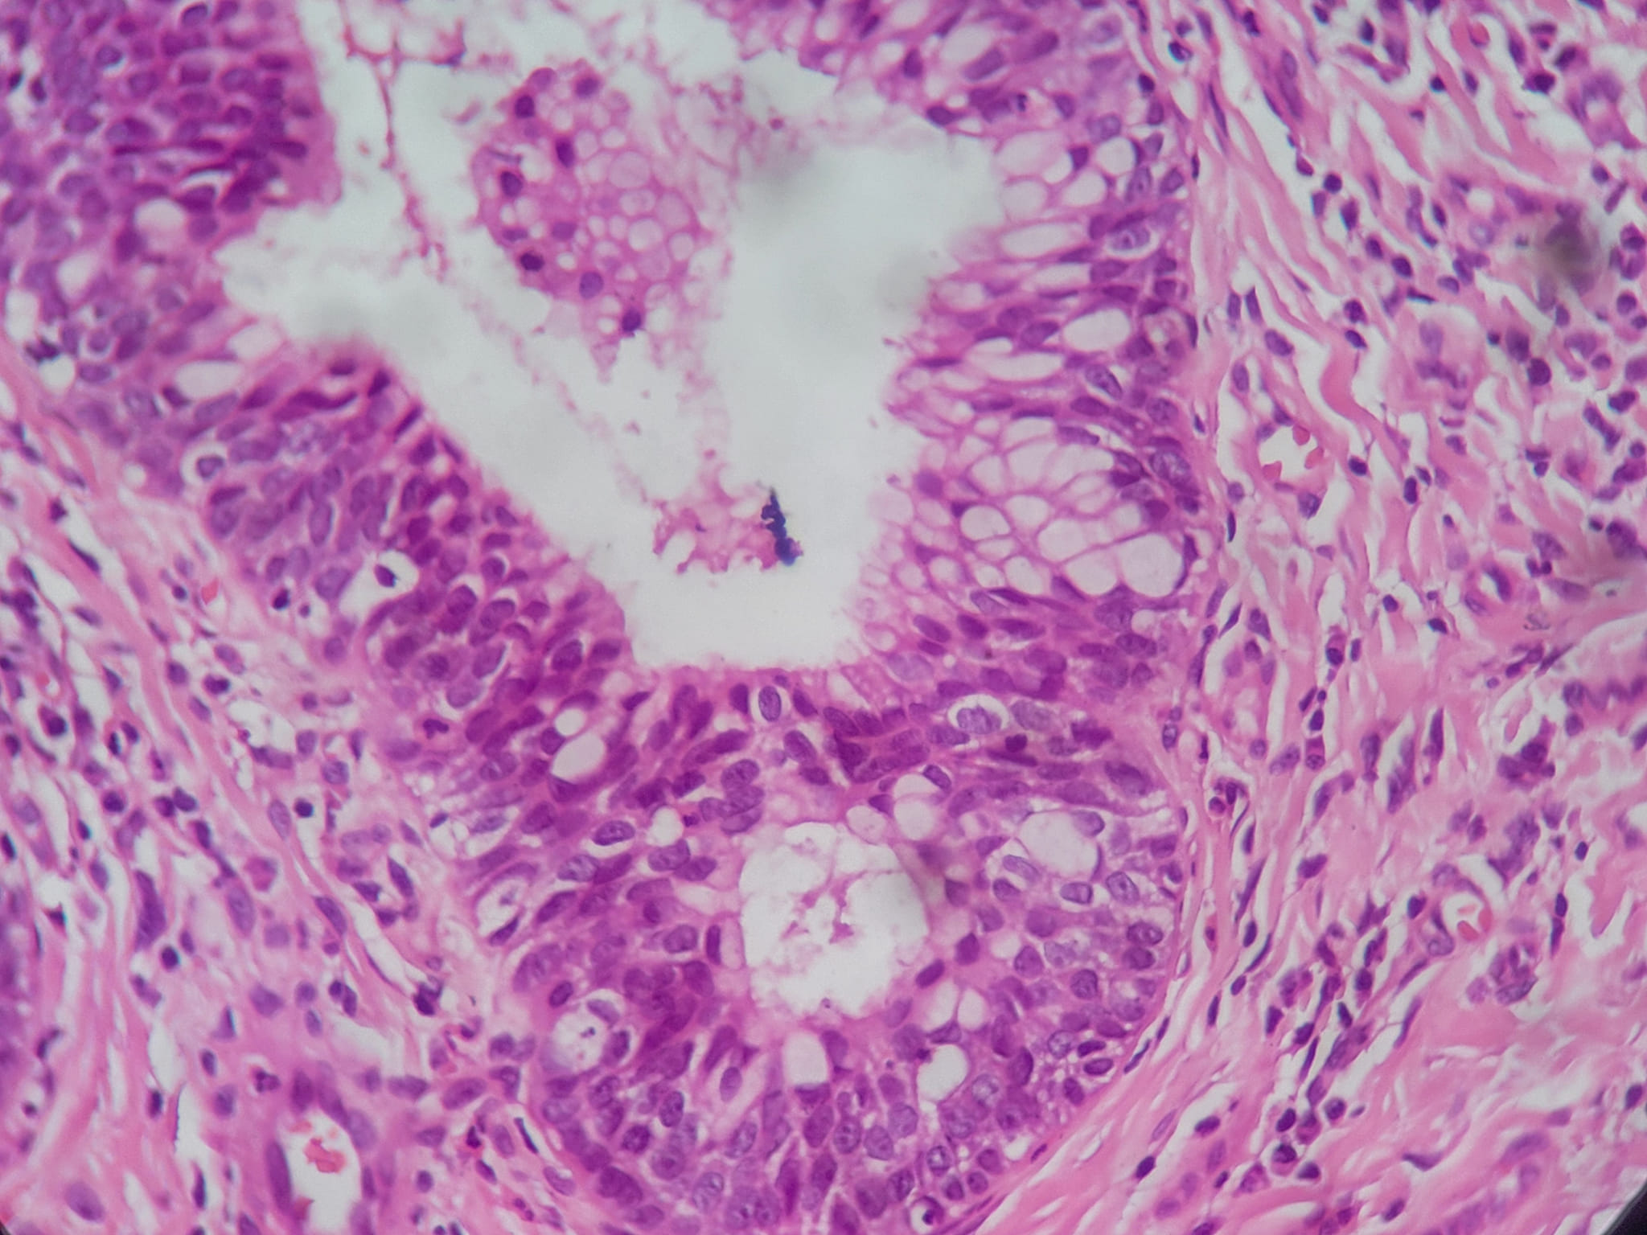
Células caliciformes

Slide 8
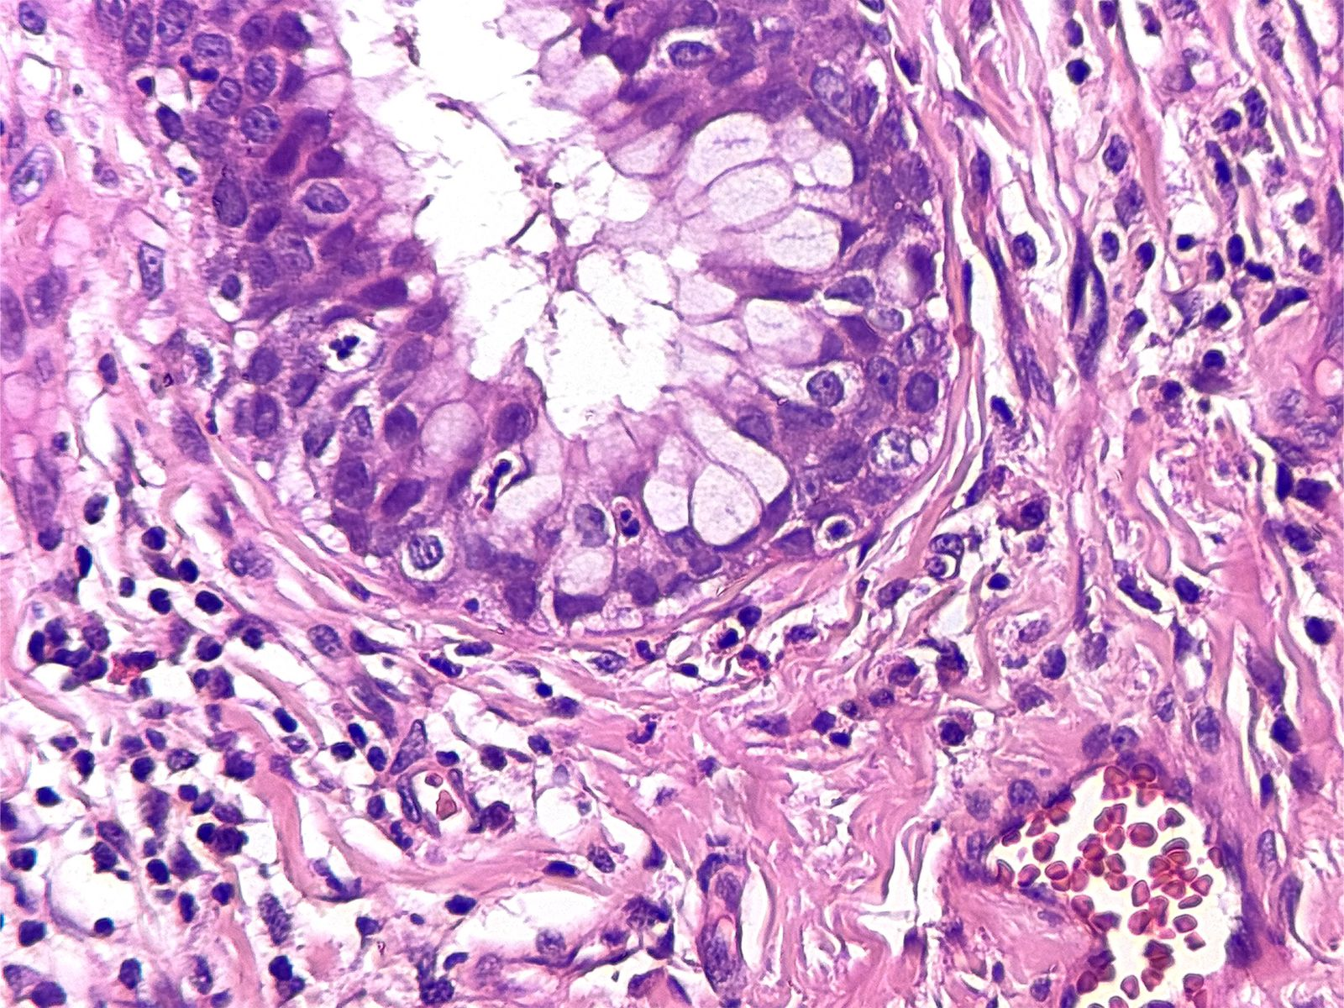
Células caliciformes

Slide 9
Células caliciformes

Slide 10
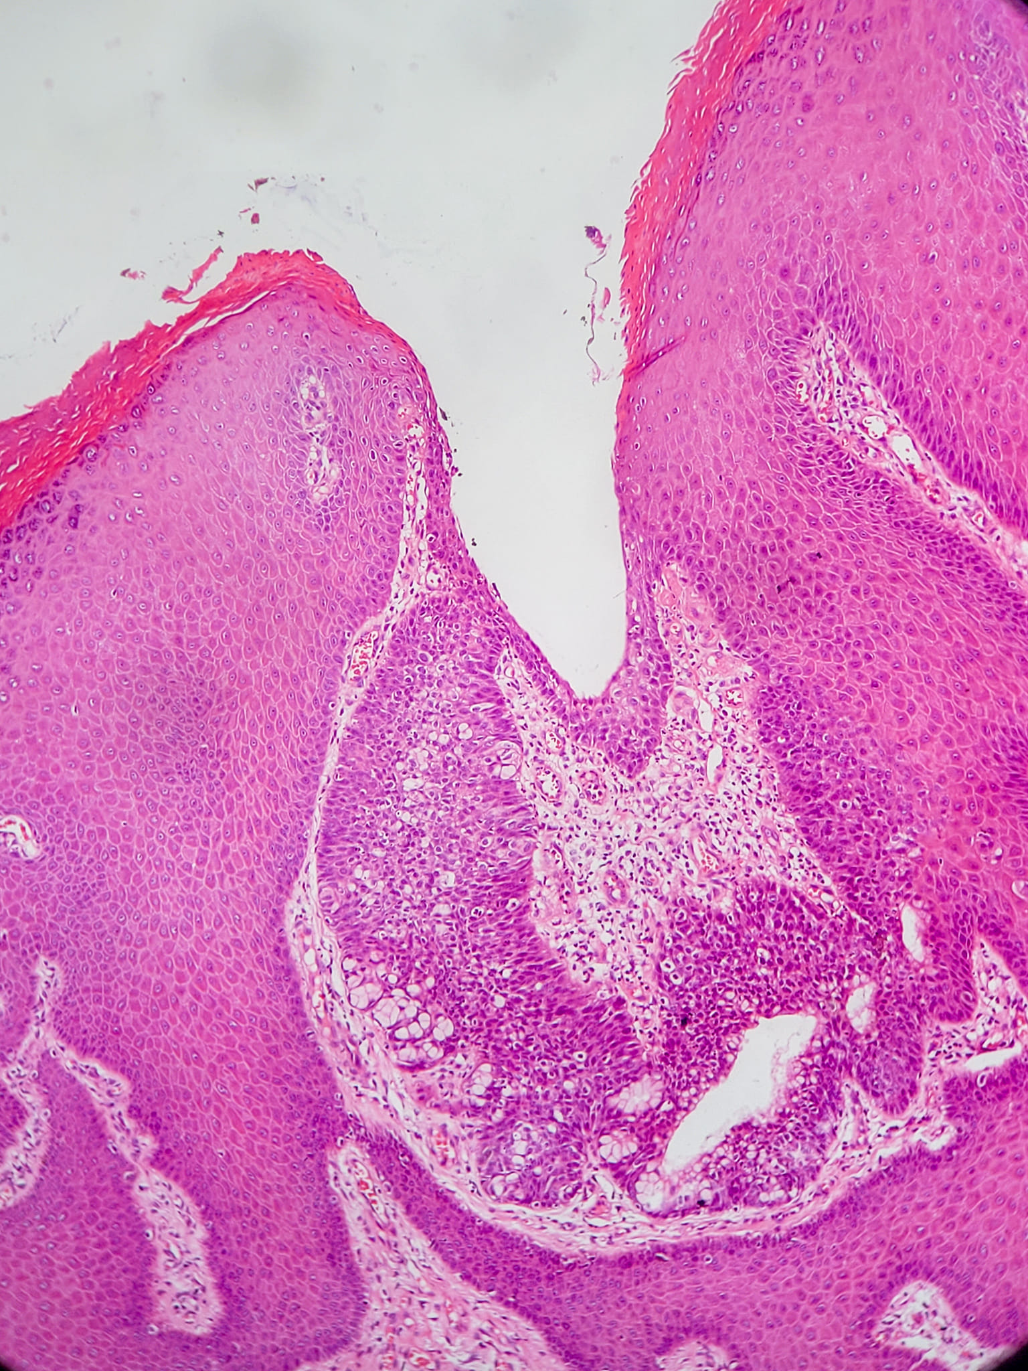

Slide 11
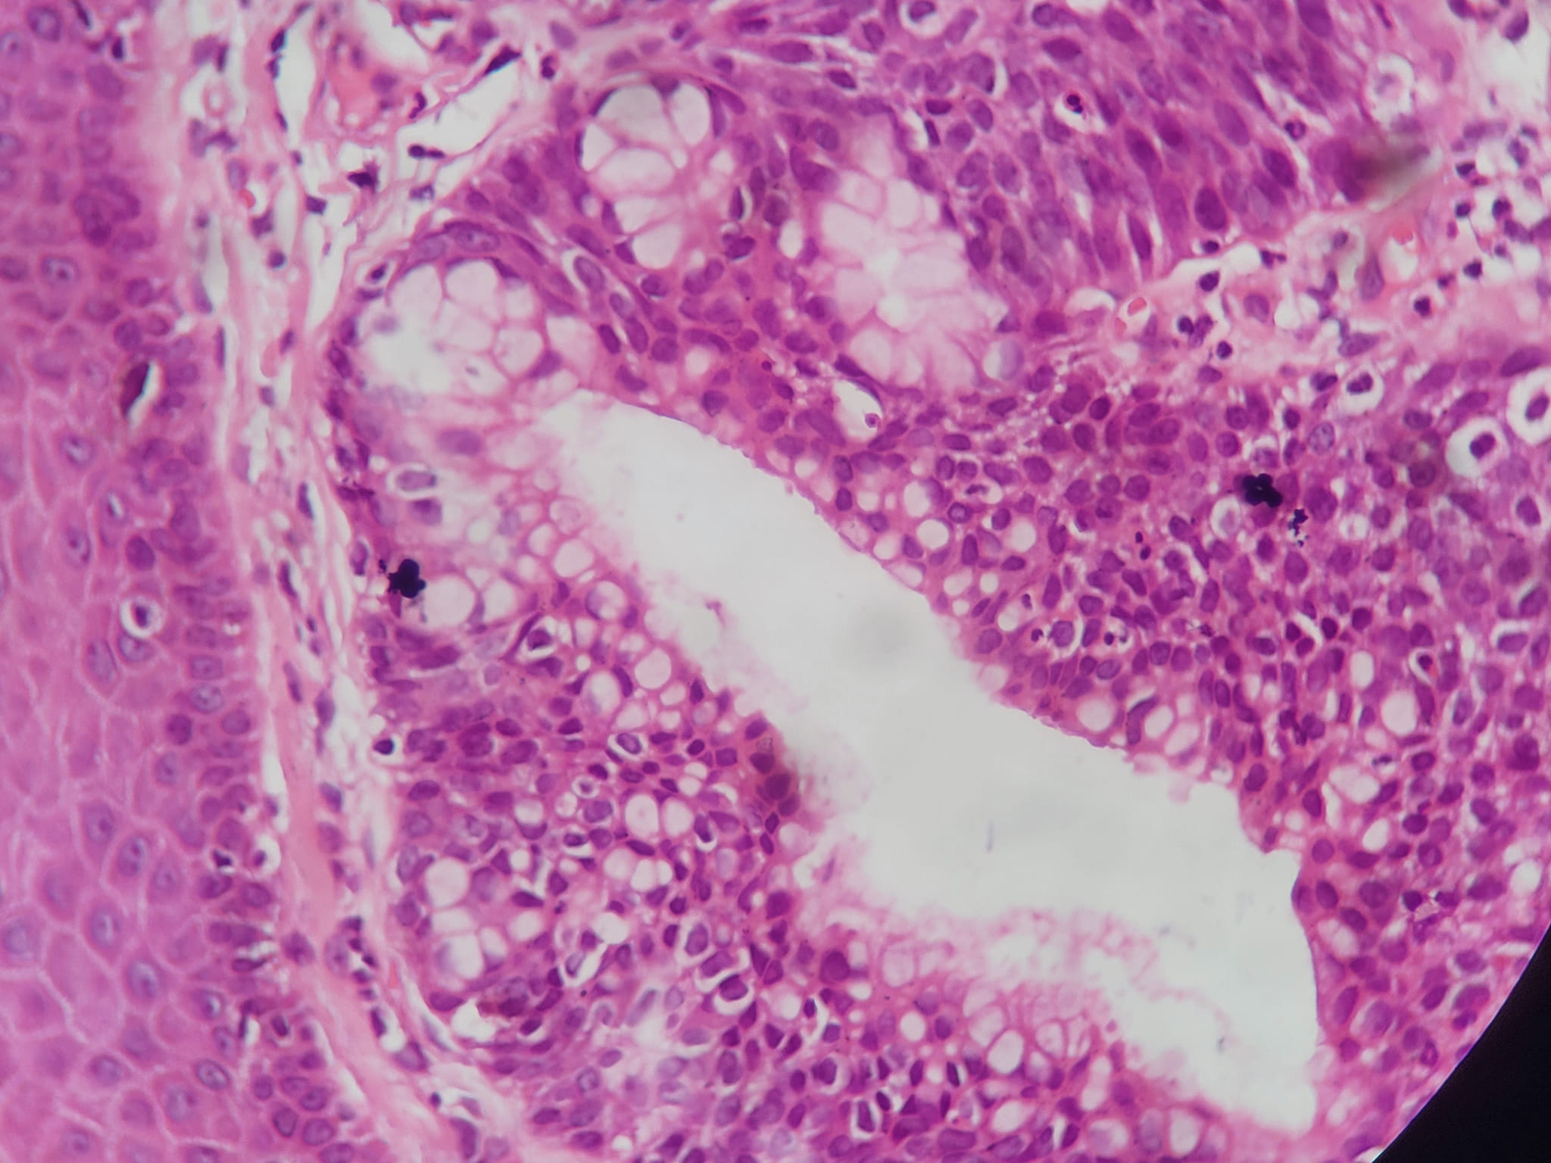

Slide 12
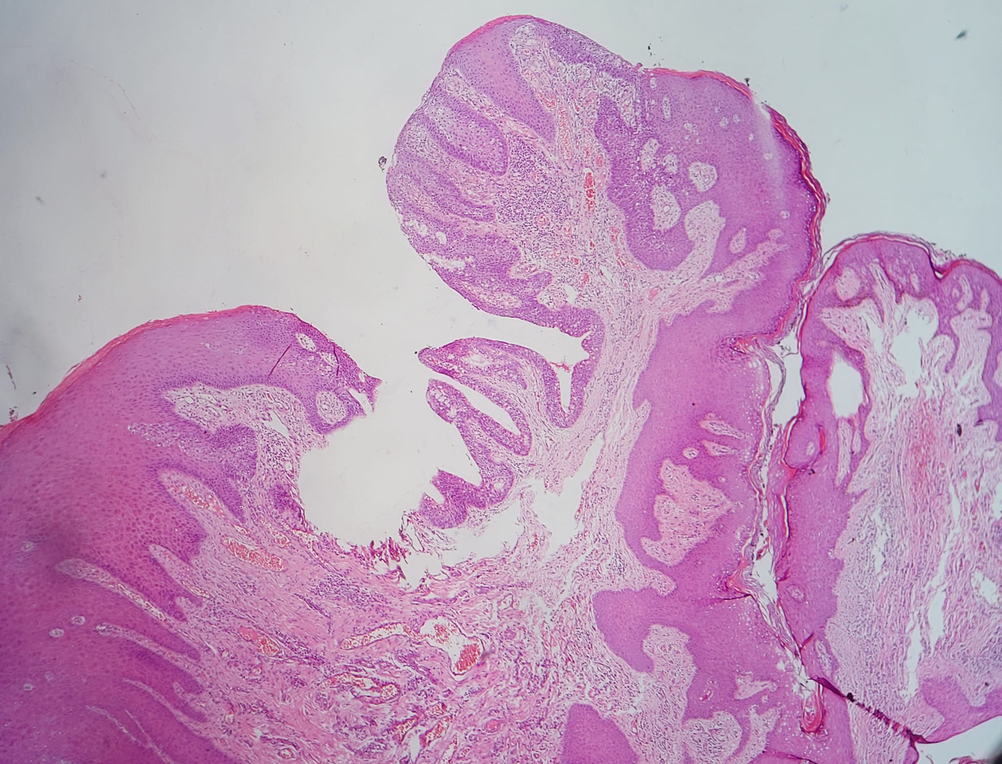

Slide 13
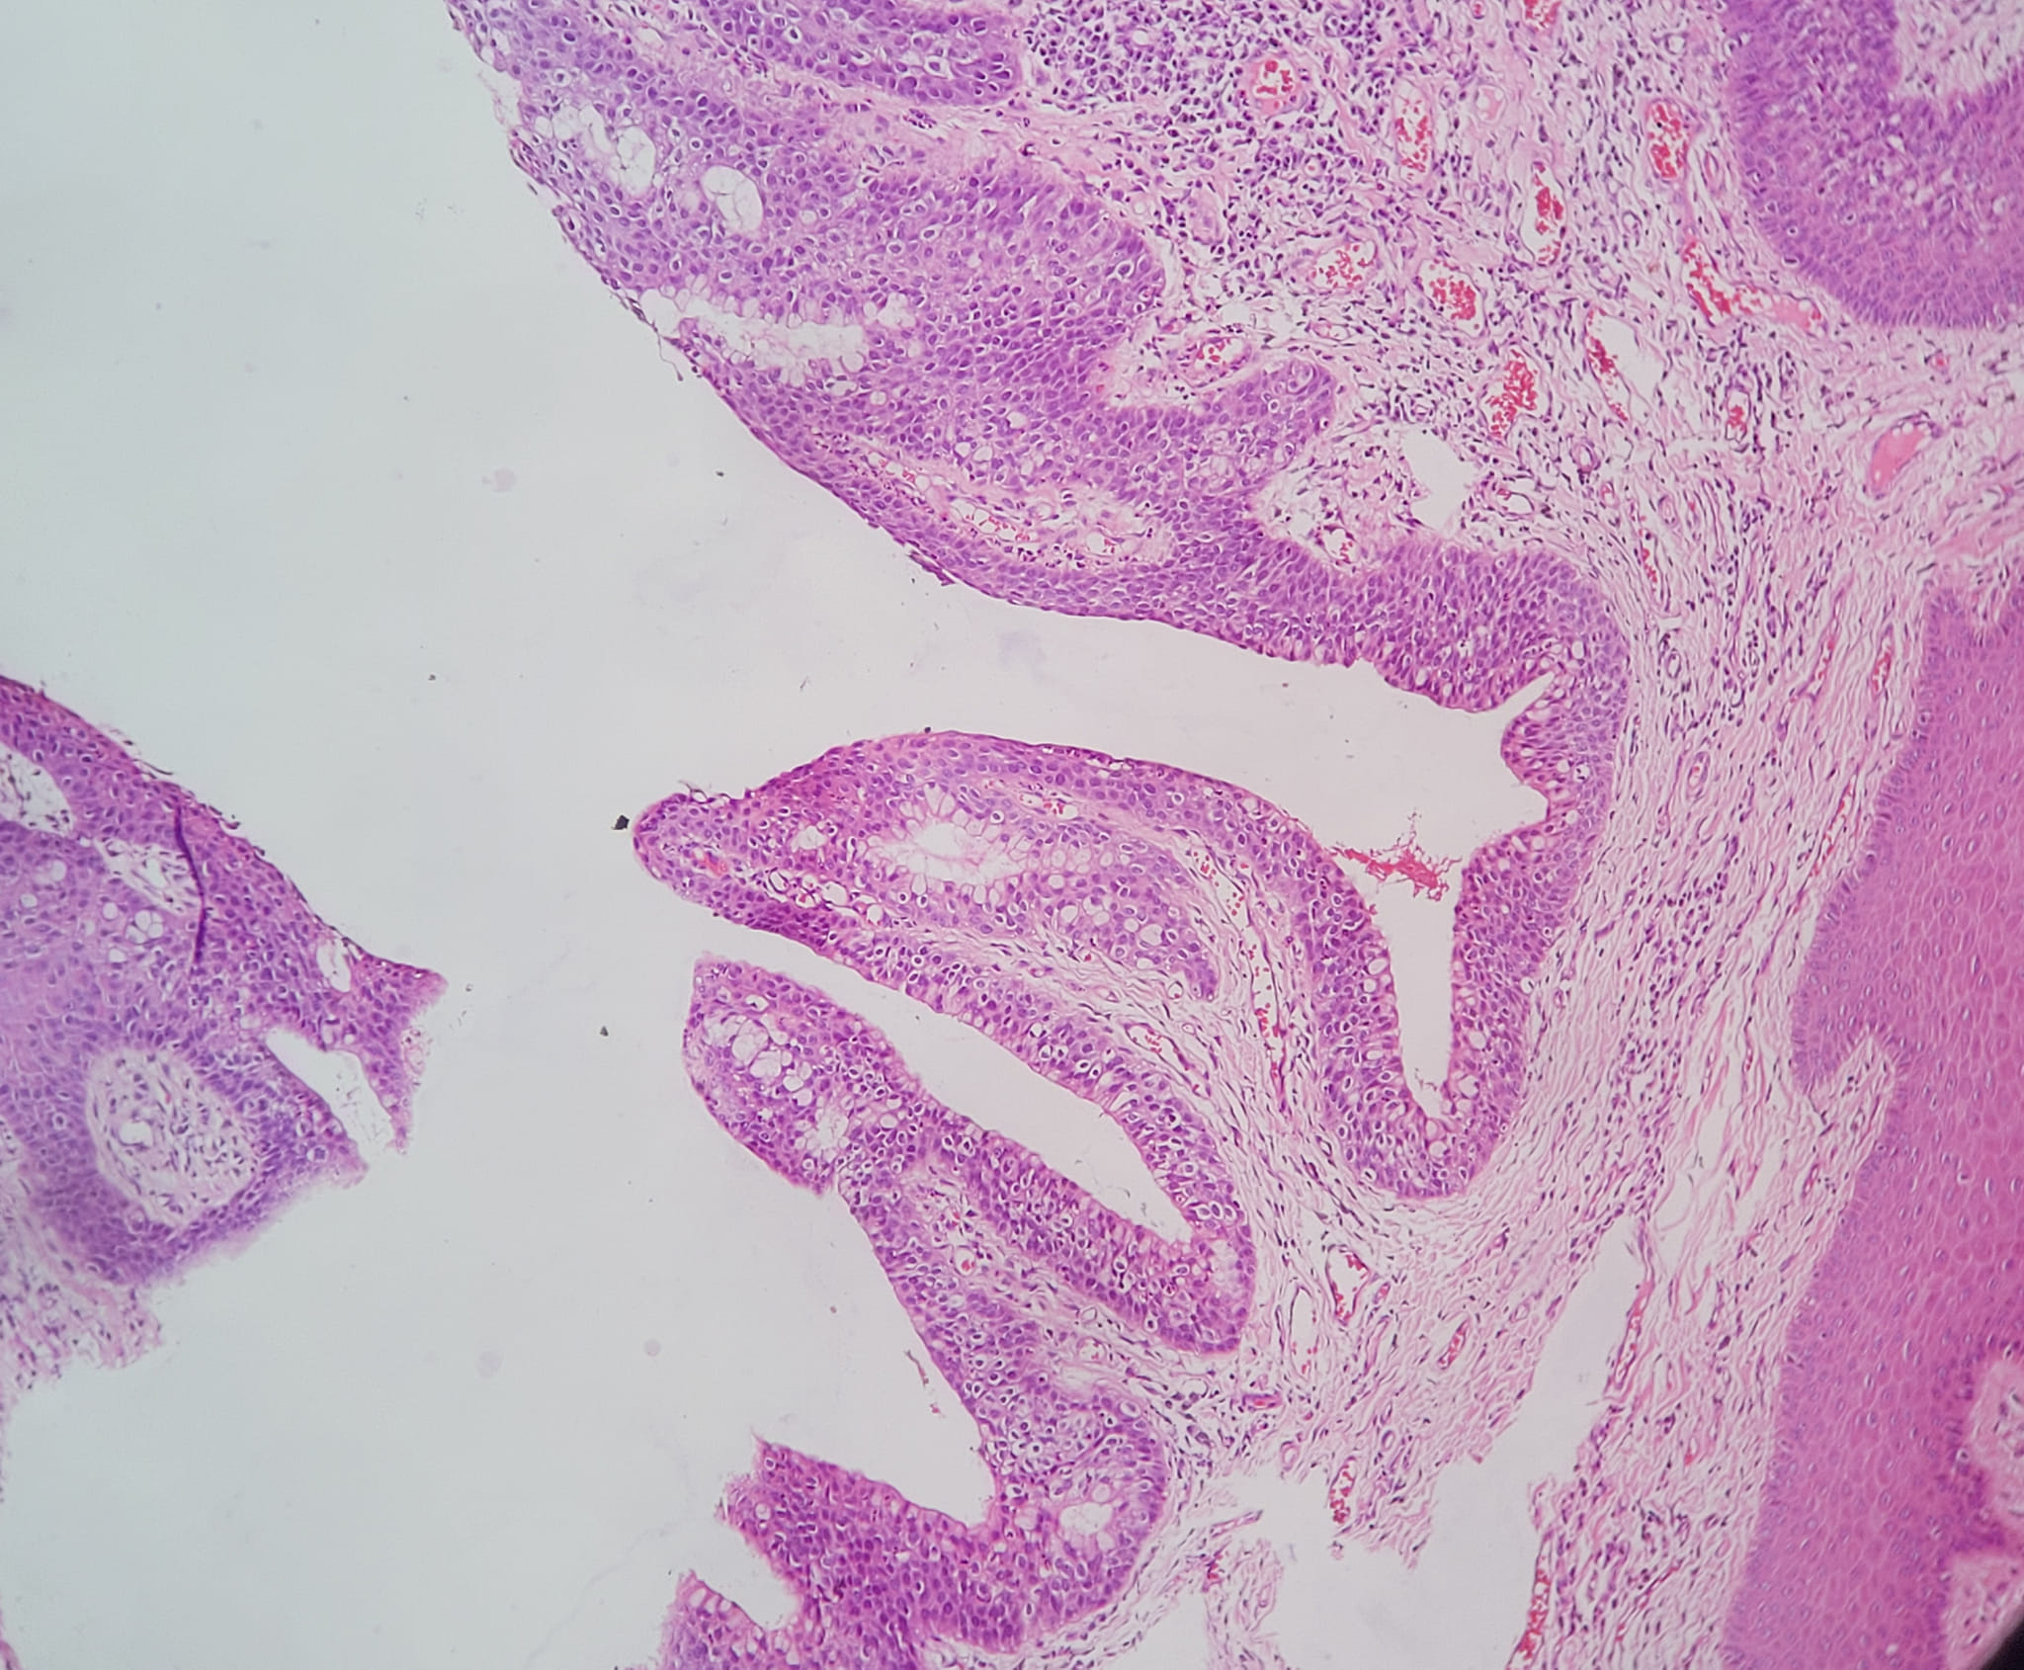

Slide 14
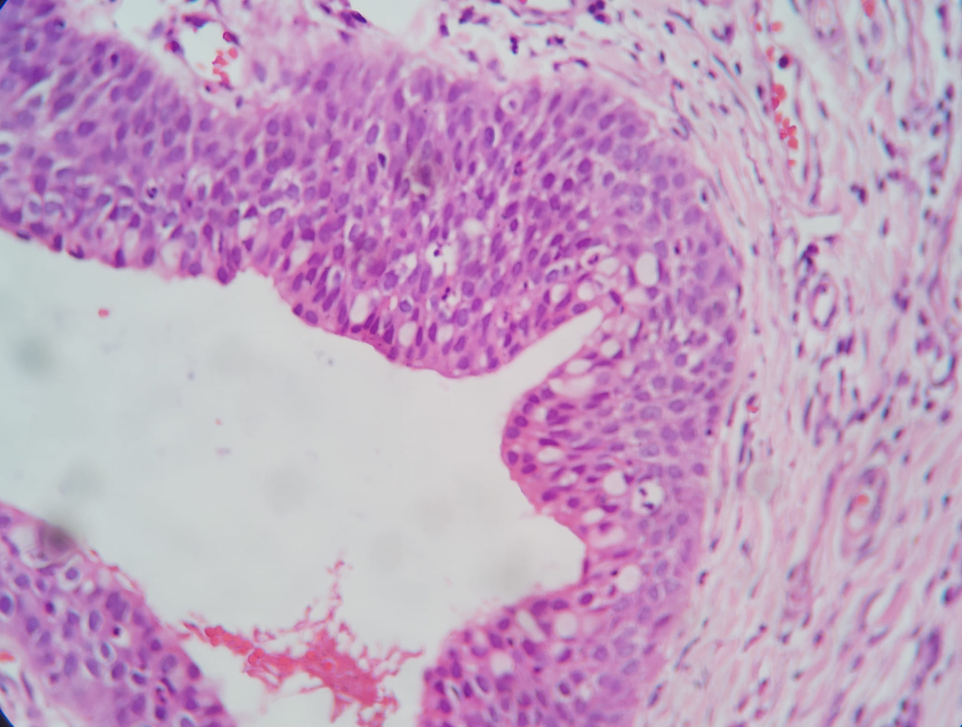

Slide 15
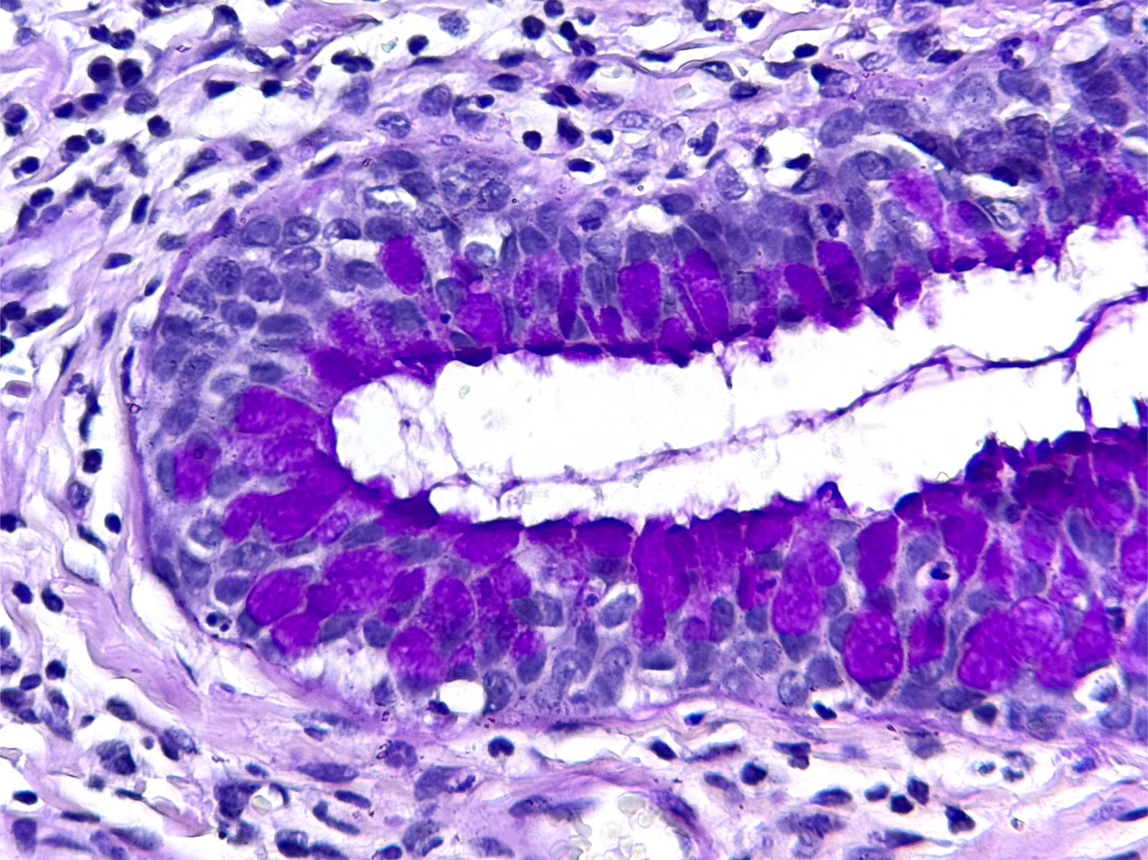
PAS

Slide 16
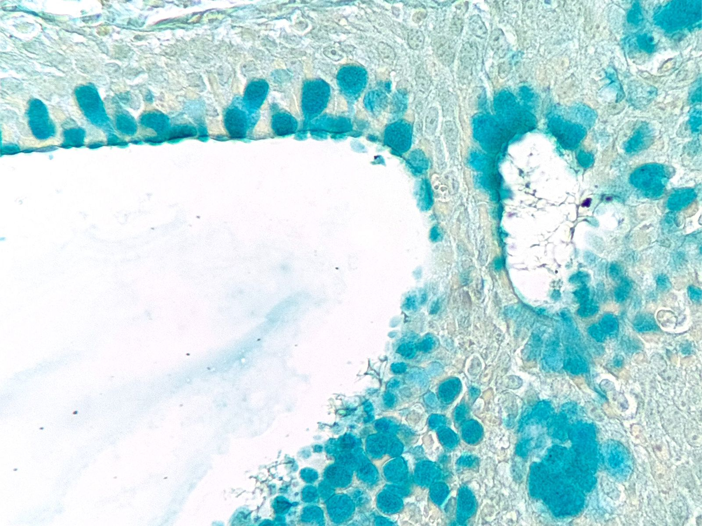
Alcian Blue

Slide 17
Hipóteses diagnósticas?

Slide 18
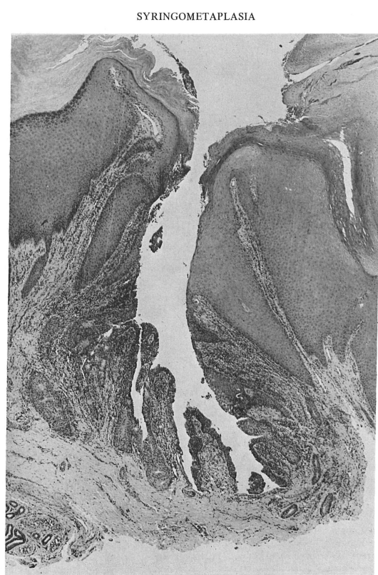
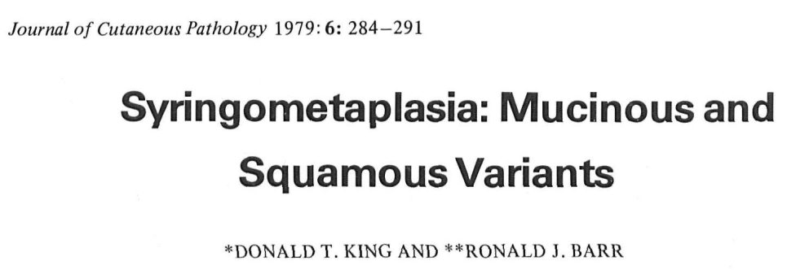
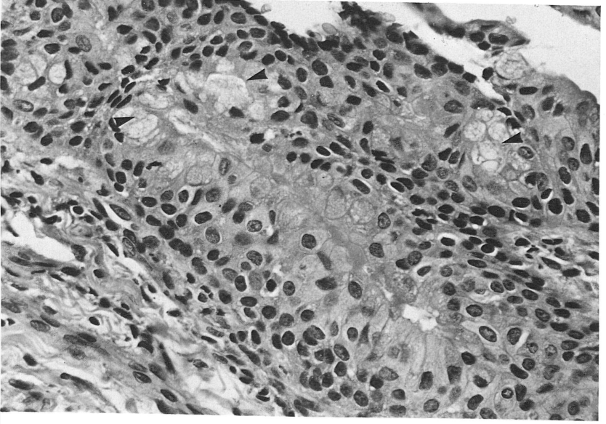
Notes:
The term mucinous syringometaplasia was coined in 1979 by King and Barr when they described a solitary skin lesion, which drained serous fluid, in the left heel of a 23-year-old patient.
Case 1: Microscopic sections revealed features of a benign keratosis consistent with a verruca plantaris. The epidermis exhibited marked hyperkeratosis, parakeratosis, hypergranulosis, verrucous acanthosis, focal vacuolation of squamous keratinocytes and a toeing-in arrangement of the rete ridges (Fig. 1). Within the central portion of the lesion there was an invagination which was lined by keratinocytes admixed with mucin-containing goblet cells. Multiple sections revealed that these mucin-containing cells lined intraepidermal and intradermal eccrine sweat ducts (Fig. 2). The goblet cells were positive with the Alcian blue (pH2.5) and mucicarmine stains. The dermis contained a moderate inflammatory cell infiltrate composed of lymphocytes, histiocytes and polymorphonuclear leukocyte

Slide 19
Notes:
The term mucinous syringometaplasia was coined in 1979 by King and Barr4 when they described a solitary skin lesion, which drained serous fluid, in the left heel of a 23-year-old patient.
Case 1: Microscopic sections revealed features of a benign keratosis consistent with a verruca plantaris. The epidermis exhibited marked hyperkeratosis, parakeratosis, hypergranulosis, verrucous acanthosis, focal vacuolation of squamous keratinocytes and a toeing-in arrangement of the rete ridges (Fig. 1). Within the central portion of the lesion there was an invagination which was lined by keratinocytes admixed with mucin-containing goblet cells. Multiple sections revealed that these mucin-containing cells lined intraepidermal and intradermal eecrine sweat ducts (Fig. 2). The goblet cells were positive with the Alcian blue (pH2.5) and mucicarmine stains. The dermis contained a moderate inflammatory cell infiltrate composed of lymphocytes, histiocytes and polymorphonuclear leukocyte

Slide 21
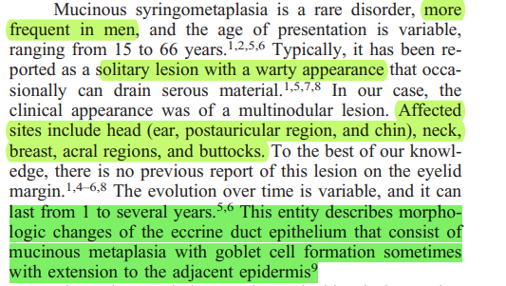

Slide 22
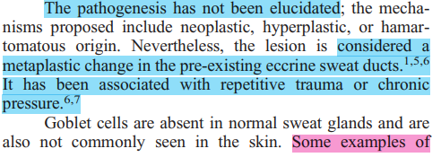

Slide 23
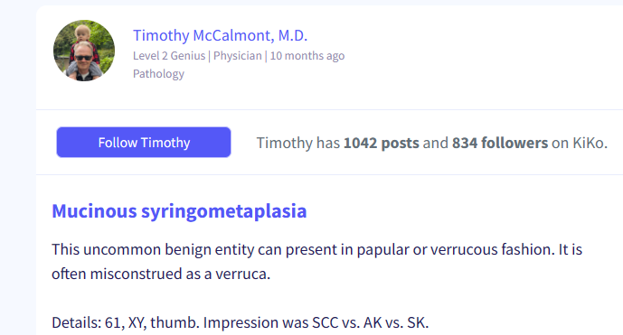
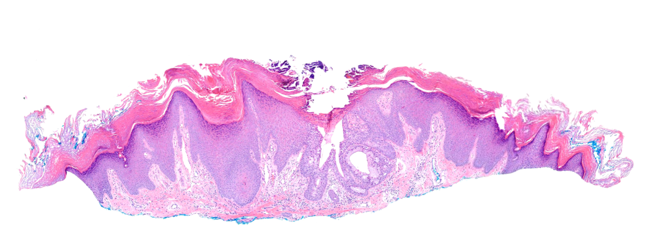

Slide 24
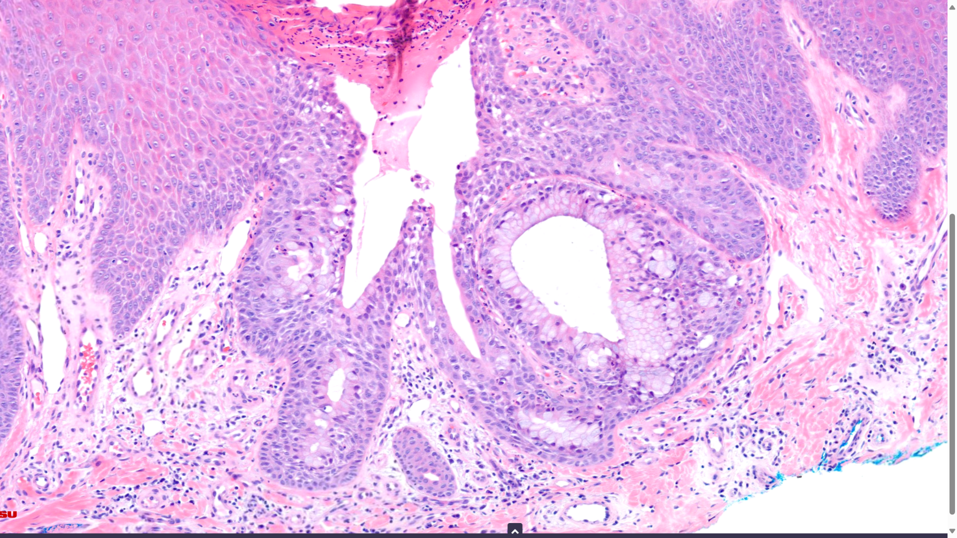

Slide 26
Siringometaplasia Mucinosa
Take Home Messages

Slide 27
Siringometaplasia Mucinosa
19 casos descritos
Lesão papular ou verrucosa, acral (outros locais descritos)
Acantose verrucosa com invaginação contendo células caliciformes
Patogênese: trauma? Neoplasia benigna?
Rafael de Deus Moura

Slide 28
obrigado!
@rafaeldmoura
dedeusmoura1

